Slide 1

HGF for Behavioural Analysis: Perceptual Model for Anxiety Patients During Lockdown
Branca Francesco, Menini Davide, Sangalli Sara

Slide 2








Motivation: Lockdown in Italy
Lack of healthcare goods
Project Idea
Tests
Tests
Today
Mar
Apr
May
Jun
2020
Lockdown
Phase 2

Slide 3











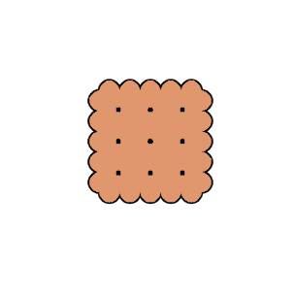
Goal: HGF for Anxiety Recognition
Anxiety Quiz
GOAL
(Ground Truth)
webapp
HGF
Psychologically Involving Test
webapp
HGF
= Healthy Controls
= Anxious Patients
Impartial Test
webapp
HGF

Slide 4
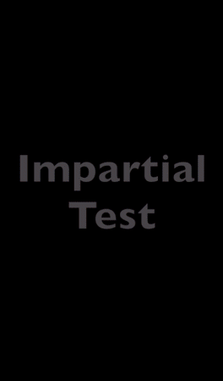
Experiment: Setup
Anxiety Quiz: 20 questions based on STAI. * 5 levels of anxiety detected, but only interested in a binary decision for results’ validation.
Involving Test: Sanitizers in shop A (y | n) Are there sanitizers in shop B?
Impartial Test: Biscuits in shop A (y | n) Are there biscuits in shop B?
* https://en.wikipedia.org/wiki/State-Trait_Anxiety_Inventory

Slide 5
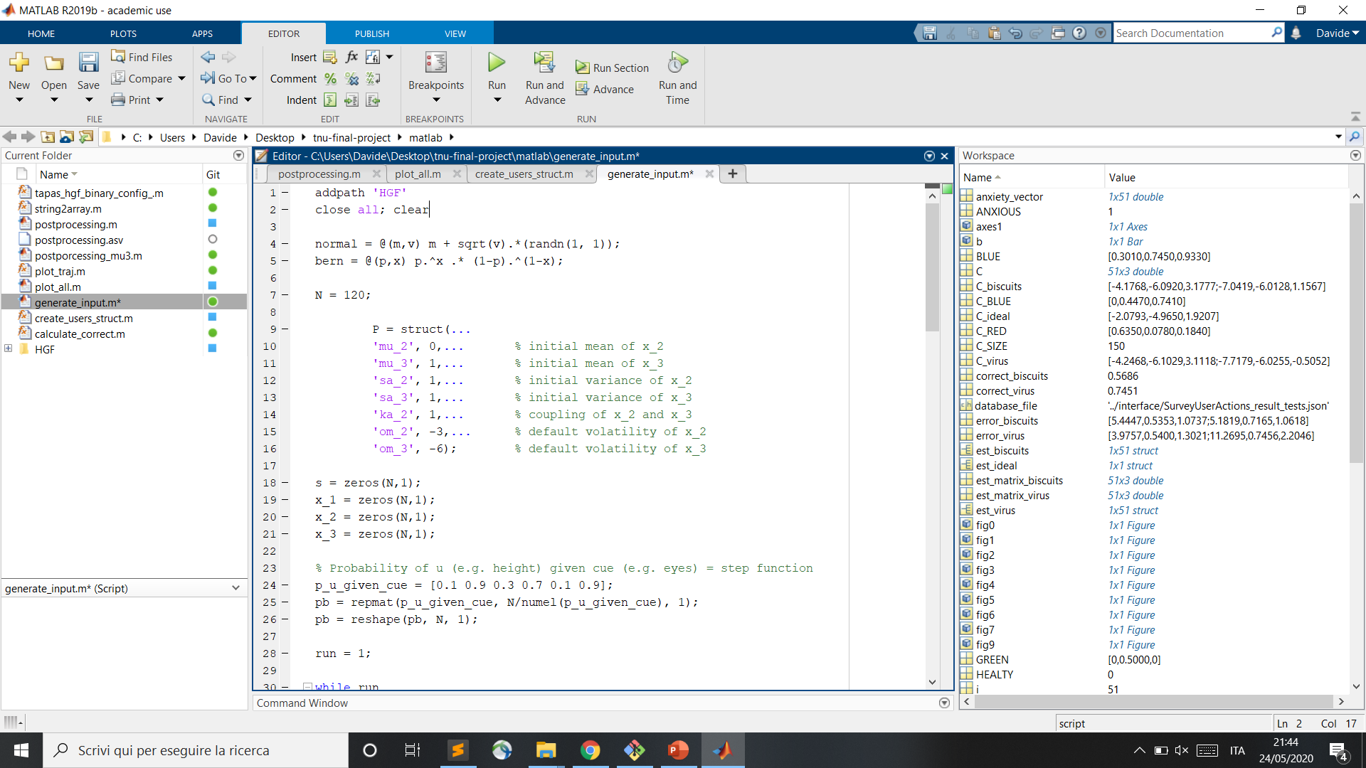
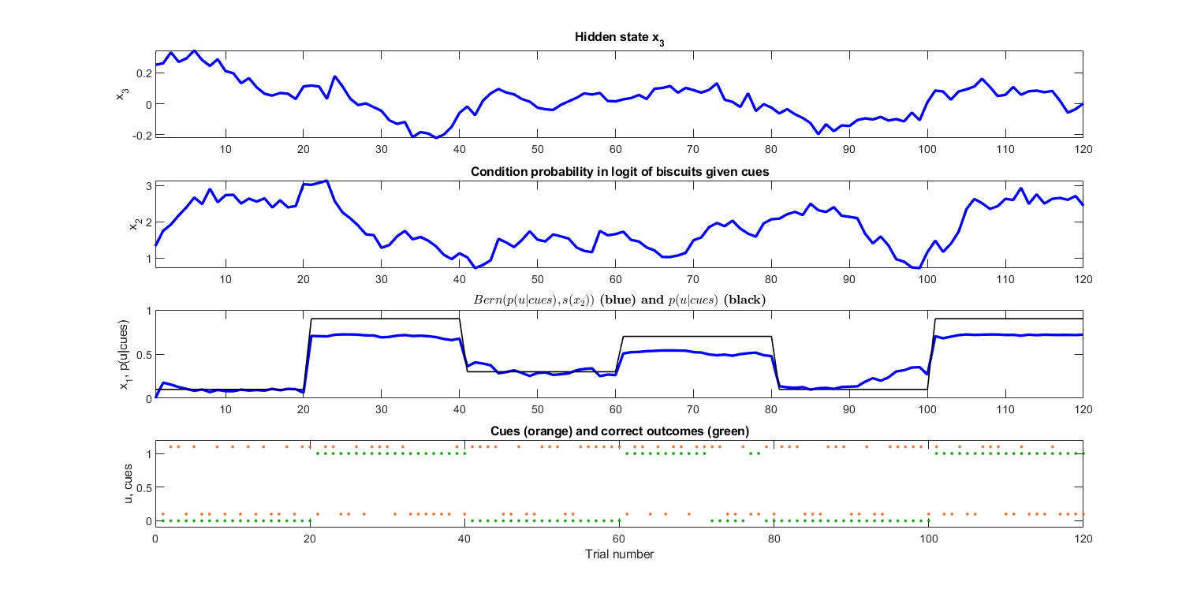
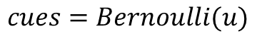
Experiment: Inputs
Correct Outcomes:
Cues:
$$u=GenerativeModel(P, p(u|cues))$$
$$cues=Bernoulli(u)$$

Slide 6
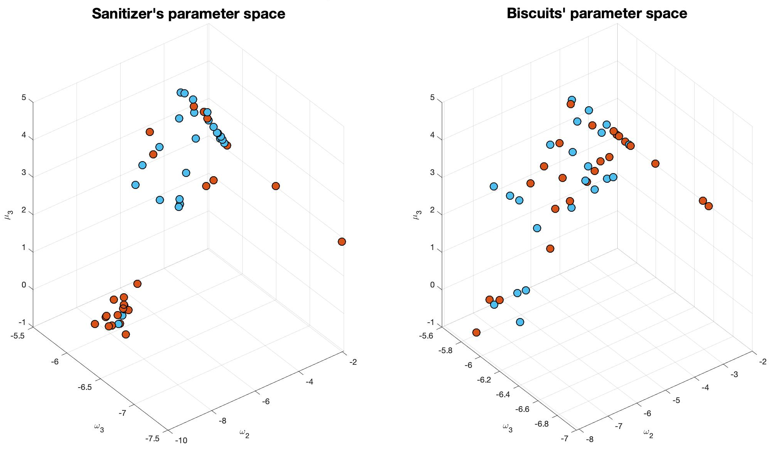
Parameters’ Estimation: Involving vs. Impartial
= Healthy Controls
= Anxious Patients

Slide 7
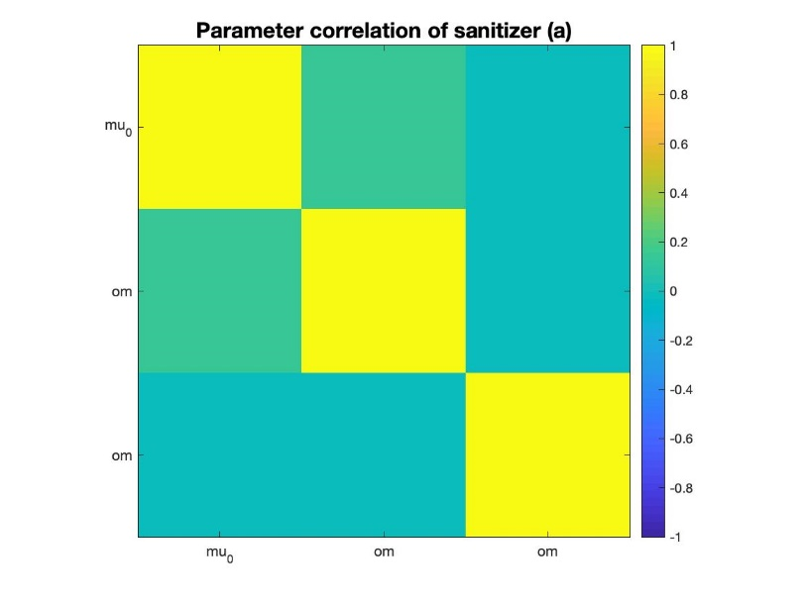
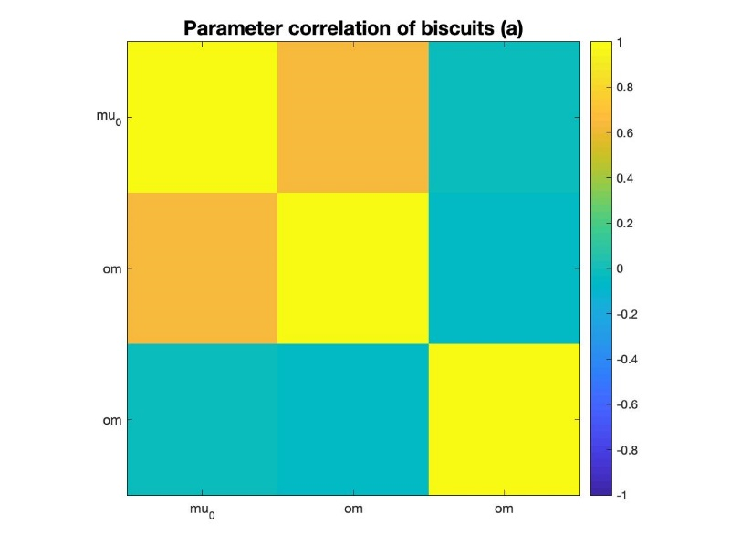
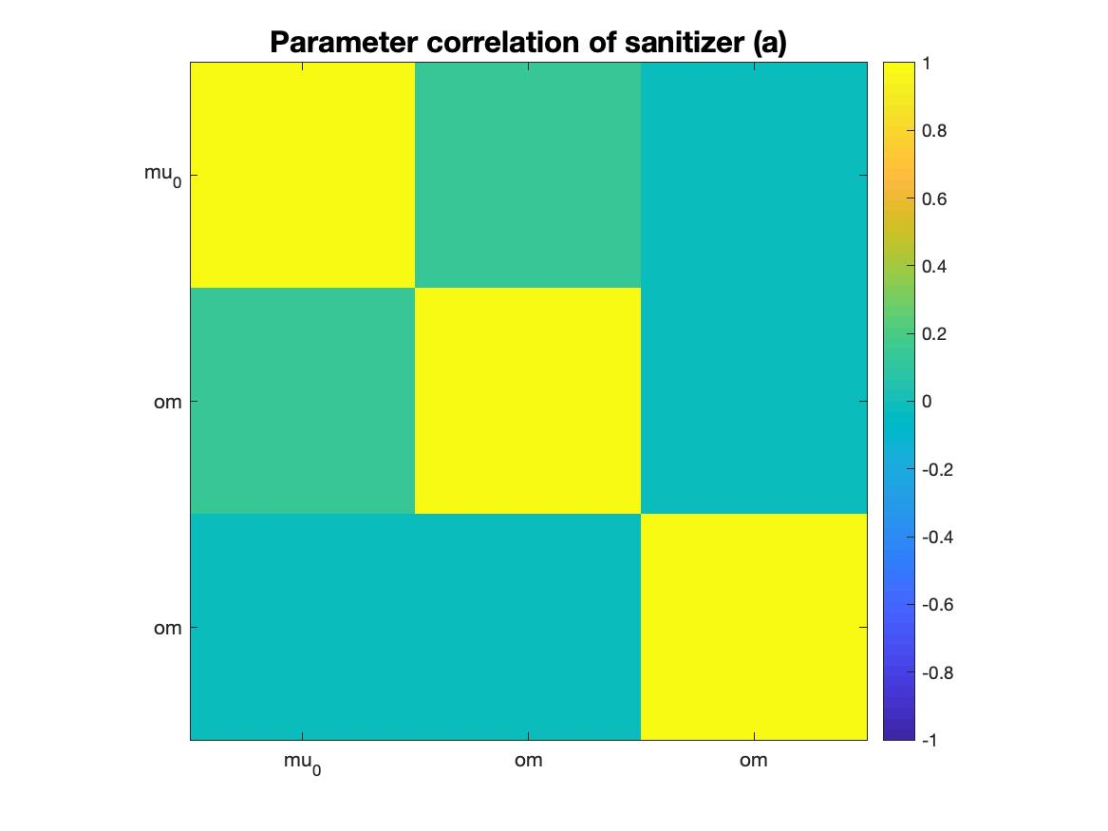
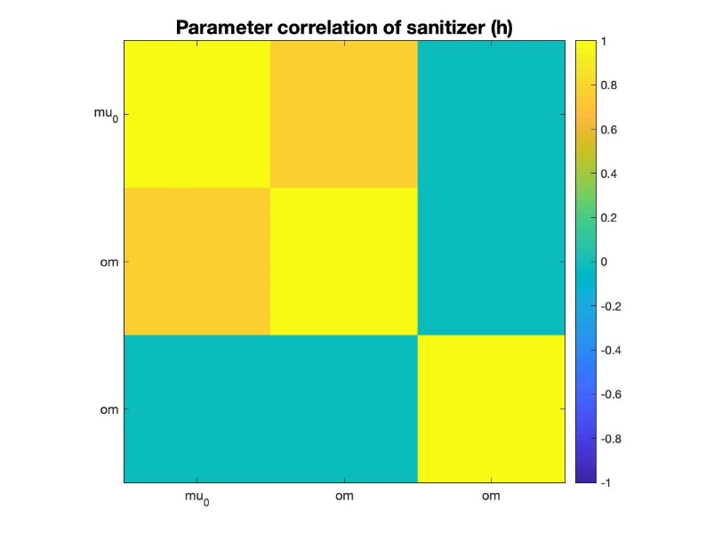
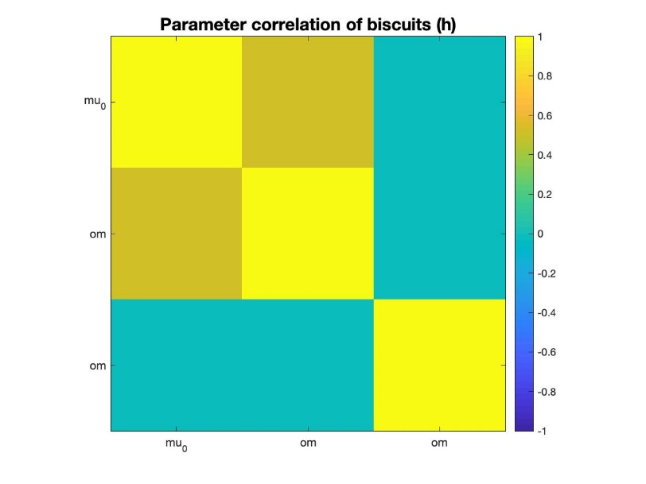
Parameters’ Correlation
Anxious
Healthy
Involving
Impartial

Slide 8
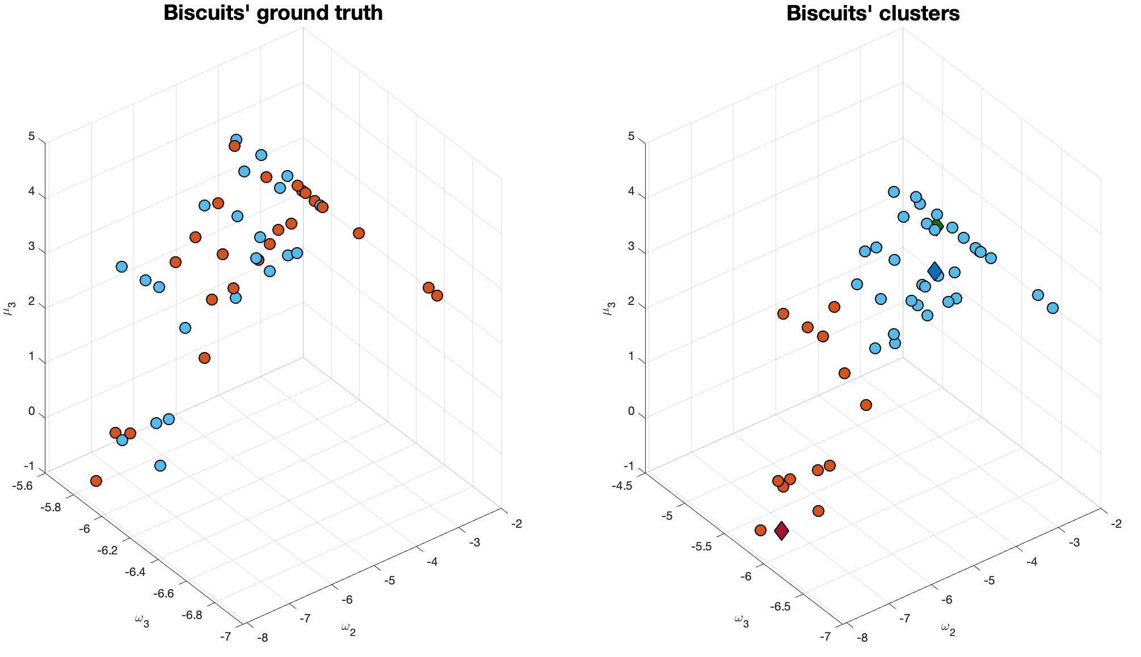
K-Means Clustering: Impartial Context
= Healthy Controls
= Anxious Patients
= Healthy Centroid
= Anxious Centroid
= Ideal Model

Slide 9
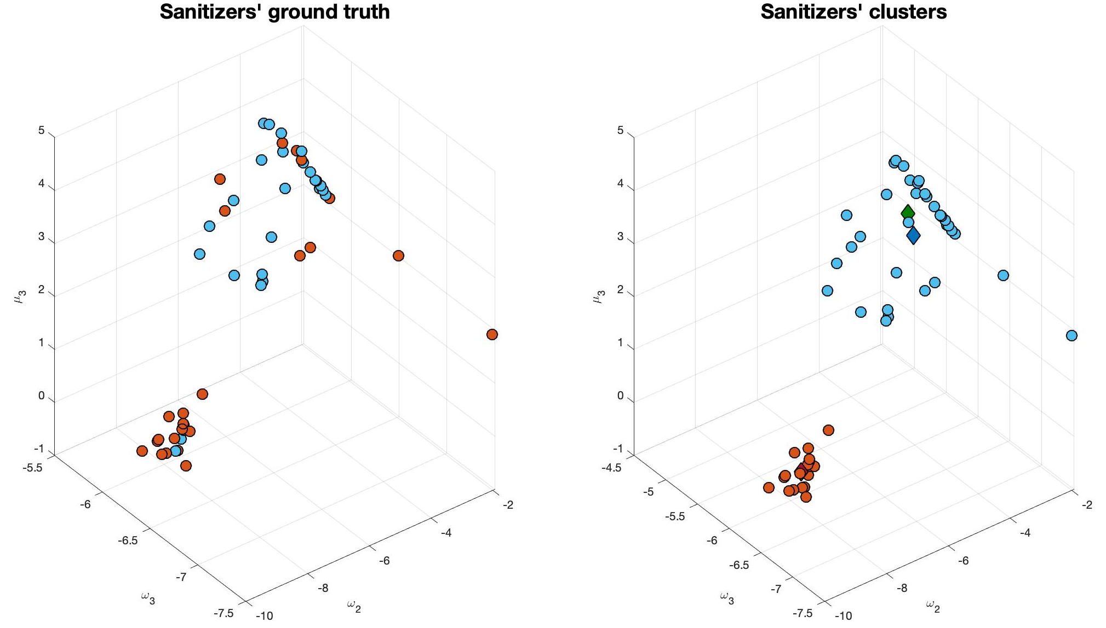
K-Means Clustering: Involving Context
= Healthy Controls
= Anxious Patients
= Healthy Centroid
= Anxious Centroid
= Ideal Model

Slide 10
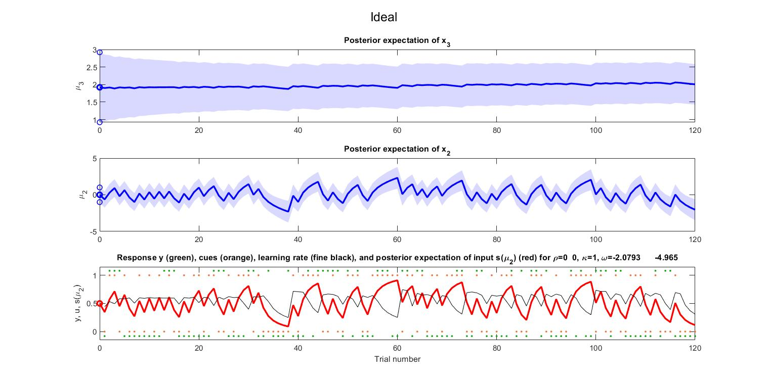
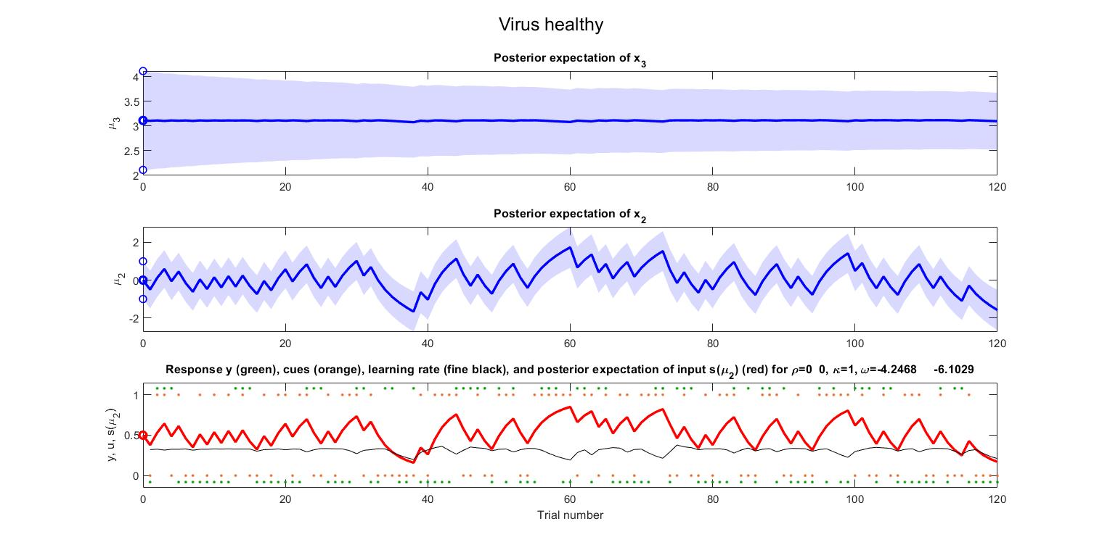
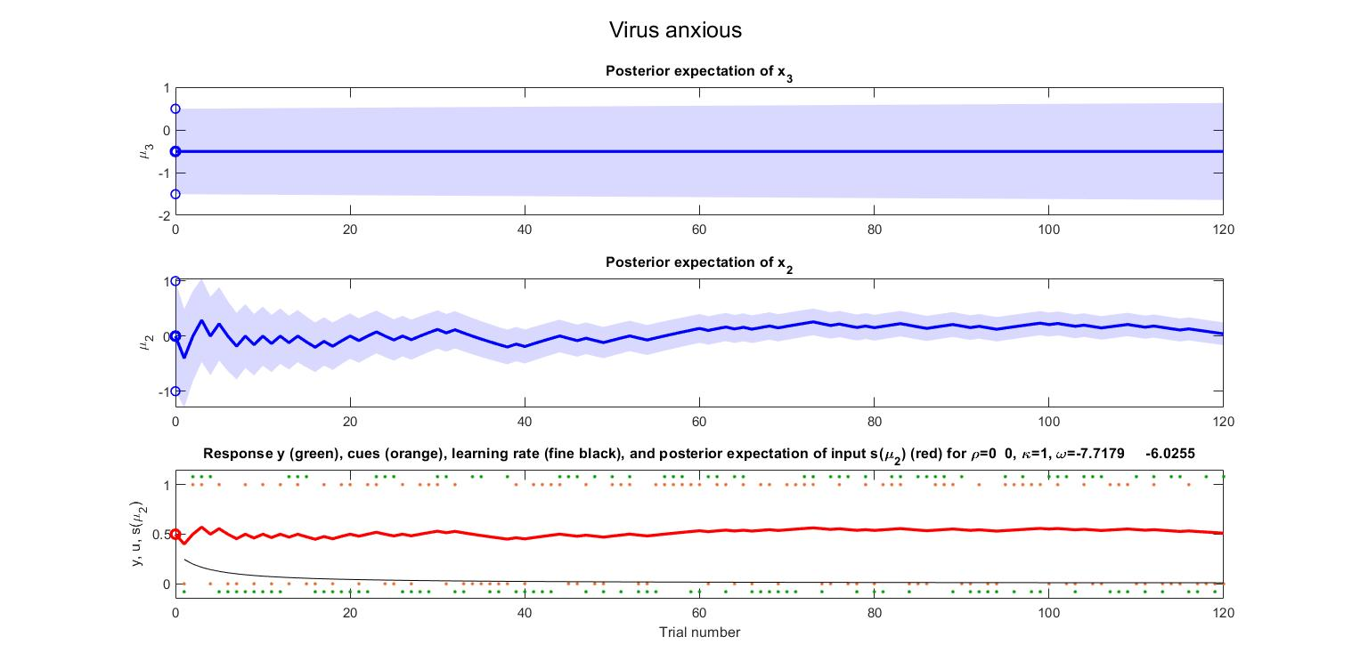
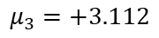
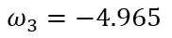
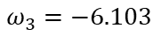
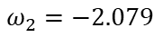
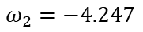
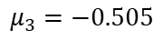
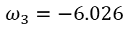
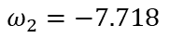
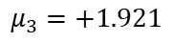
Comparison of Simulations: Ideal vs. Involving Test’s Centroids
Ideal
$$ω_{2}=−2.079$$
$$ω_{3}=−4.965$$
$$μ_{3}=+1.921$$
Healthy
SCORE = 50%
$$ω_{2}=−4.247$$
$$ω_{3}=−6.103$$
$$μ_{3}=+3.112$$
Anxious
SCORE = 47.5%
$$ω_{2}=−7.718$$
$$ω_{3}=−6.026$$
$$μ_{3}=−0.505$$

Slide 11
Final Results: Summary
All the subjects behave in similar ways in an impartial context
Healthy Controls behave differently than Anxious Patients in a psychologically involving context
Healthy Controls have a higher score, closer to the ideal model
Clustering and scores support our hypothesis on anxiety during lockdown in Italy

Slide 12
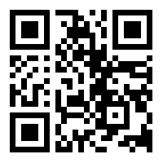
Thank you for your attention!
https://tnutest.altervista.org/

